Slide 1

Medium-altitude Earth Orbiting Search and Rescue
(MEOSAR): Globally Designed Next Generation of Satellite-Aided Search and Rescue
Christopher O’Connors NESDIS/OPSO/SPSD
Deputy Chief, Satellite Products and Services Division and SARSAT Program Manager
11 April 2016
http://www.sarsat.noaa.gov
http://www.cospas-sarsat.int
NOAA Satellite and Information Service | Office of Satellite and Product Operations

Slide 2
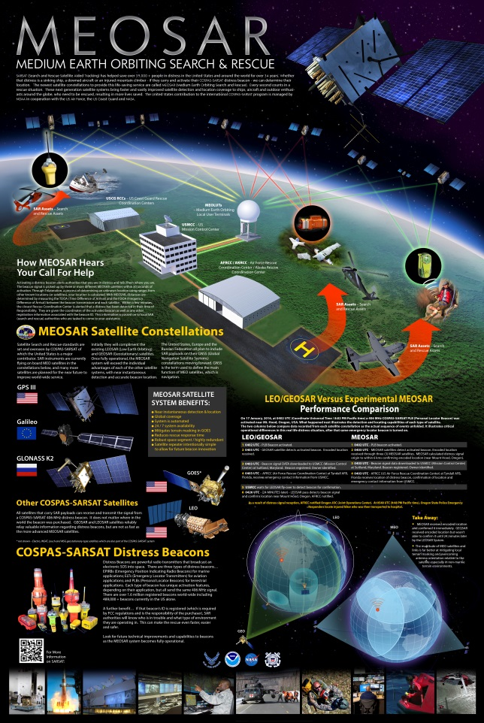
Outline
SARSAT Overview
Cospas-Sarsat Overview
LEO/GEO Overview
MEOSAR Overview
Case Studies with the Experimental System

Slide 3
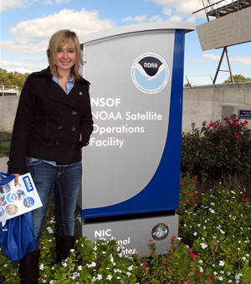

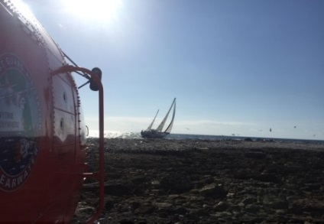
Search and Rescue Satellite Aided Tracking (SARSAT)
Benefits of SARSAT:
Shorter searches
  “Golden Hour”, shorter response increase the likelihood of survival
  Reduces risks to search teams
  Reduces response costs
Economic benefits
  Creates jobs - 9 US Beacon manufacturers
  Contributes to the economy - manufacturers produce thousands of distress beacons per year ~$437M invested in Beacons
SARSAT Lives Saved
  2015 250 saves (128 at sea in 46 incidents, 21 aviation in 11 incidents, and 91 terrestrial in 65 incidents)
  2014 240 saves (112 at sea in 31 incidents, 15 aviation in 7 incidents, 113 terrestrial in 72 incidents)
2014 Cost Benefit Analysis
Total benefit lives and property (Based on Department of Transportation (DOT) June 13, 2014, value of a statistical life of $9.2M)
  $1,263,477,920
Total costs of federal rescue operations and SARSAT operation
  $36,524,649 (State and local costs unknown)
Net Benefit $1,226,953,271
Cost benefit ration 33.6 to 1.0
SARSAT Rescues since 1982
World-wide: over 39,565 rescues
United States: over 7,347 rescues
October 22, 2010, Teen Sailor Abby Sunderland rescued via SARSAT
January 30, 2015, Crew of the Rain Maker with USCG Rescuers
May 22, 2015, USCG rescued two crew of sailing vessel Boxer

Slide 4



U.S. SARSAT Agencies
Inland SAR
Maritime SAR
Research & Development
System Operation
Air Combat Command (ACC)
Search and Rescue Office
Search and Rescue Laboratory
Satellite and Information Service
Representative to International Cospas-Sarsat Program

Slide 5
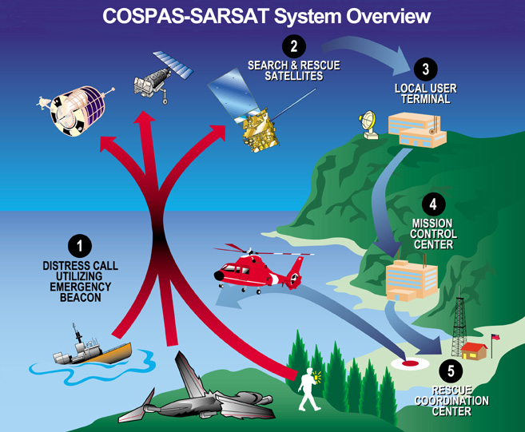
Search and Rescue Satellite Aided Tracking (SARSAT)
NOAA NESDIS is the face for the SARSAT Program
SARSAT is integrated into the global search and rescue system
  Public- beacon ownership, registration and survivors
  State and local authorities – search and rescue responders, legislate beacons
  Federal agencies – SAR case management and response, beacon users and beacon regulations
  International – mandatory carriage, beacon users, responders
The Search and Rescue Satellite-Aided Tracking (SARSAT) system relays distress signals from emergency beacons carried by aviators, mariners and land-based users to search and rescue (SAR) services. The mission of the National Oceanic and Atmospheric Administration’s (NOAA) SARSAT program is to:
Protect life and property by providing timely, accurate and reliable distress alerts to search and rescue services worldwide in an effective and efficient manner.

Slide 6

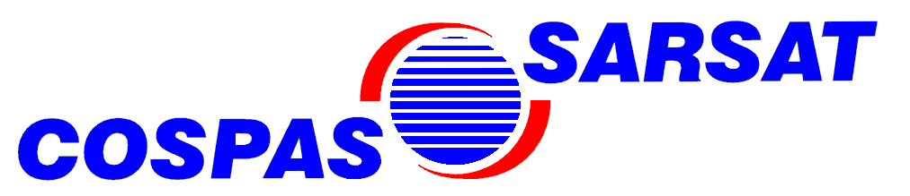
COSPAS-SARSAT
COSPAS = Cosmicheskaya Systyema Poiska Aariynyich Sudov
Which loosely translates into:
“The Space System for the Search of Vessels in Distress”
SARSAT = Search And Rescue Satellite Aided Tracking
Notes:
COSPAS: Which loosely translates into: “The Space System for the Search of Vessels in Distress”
The beginnings of Sarsat date back to 1970 when a plane carrying two U.S. congressmen crashed in a remote region of Alaska. A massive search and rescue effort was mounted, but to this day, no trace of them or their aircraft has ever been found. In reaction to this tragedy, the US congress mandated that all aircraft in the United States carry an Emergency Locator Transmitter (ELT). This device was designed to automatically activate after a crash and transmit a homing signal.
Since satellite technology was still in its infancy, the frequency selected for ELT transmissions was 121.5 MHz, the international aviation distress frequency. This system worked, but had many limitations. The frequency was cluttered, there was no way to verify who the signal was from, and most importantly, another aircraft had to be within range to receive the signal.
After several years, the limitations of ELTs began to outweigh their benefits. At that time, a satellite based system was conceived. It would operate on a frequency reserved only for emergency beacons (406 MHz), it would have a digital signal that uniquely identified each beacon, and it would provide global coverage.
In short, Cospas-Sarsat takes the “search” out of
Search & Rescue

Slide 7
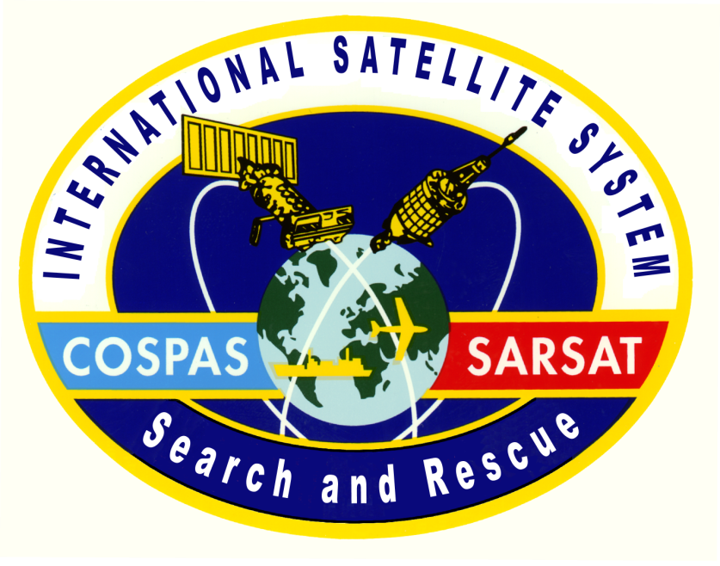
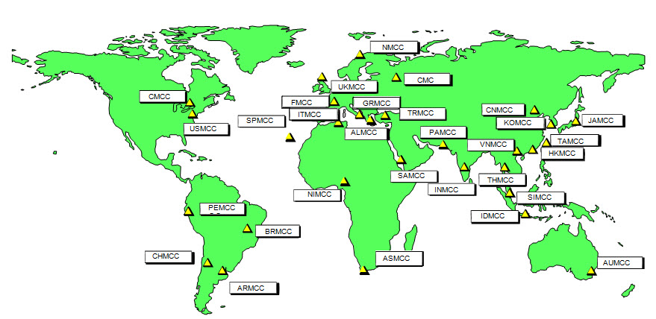
Cospas-Sarsat
Services are provided world-wide and free of charge for the user in distress
Alerts are provided using satellite and ground systems to detect, process, and relay the transmissions of emergency beacons operating on 406 MHz
Notes:
This international system was developed at the height of the cold war as an humanitarian system to save lives regardless of nationalities. This system is provided by the contributing governments free of charge. The only cost is a one time cost for the purchase of the beacons unlike some of the commercial system which usually have a combination of beacon cost as well as a subscription fee.

Slide 8
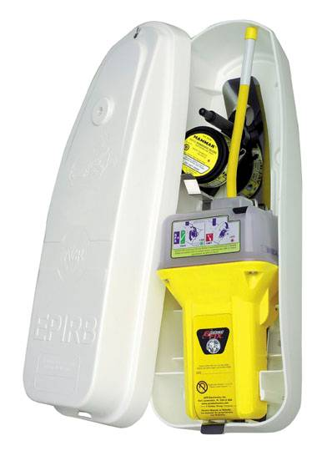
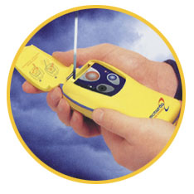
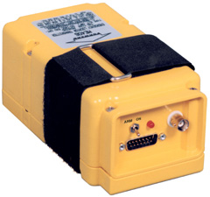
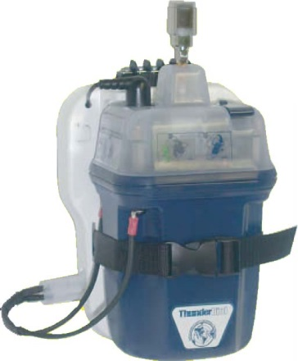
Emergency Distress Beacons
ELTs
PLBs
EPIRBs
Emergency Locator
Transmitter - aircraft
Personal Locator Beacon –
used in all environments
Emergency Position Indicating Radio
Beacon - Maritime
SSAS
Ship Security Alerting System – IMO anti-piracy applications only
Notes:
The search and rescue satellite system provides alerting services for the following types of beacons:
Emergency Locator Transmitters (ELTs) for aviation use
Emergency Position-Indicating Radio Beacons (EPIRBs) for maritime use
Personal Locator Beacons (PLBs) for applications which are neither aviation or maritime
Beacons operating at 406 MHz and 121.5 MHz are compatible with the Cospas-Sarsat System; however, the operational capabilities of the System are different for these two types of beacons.
An analogue 121.5 MHz distress beacon is a small electronic device that emits a radio signal to help rescue authorities locate your position in a life-threatening emergency. The signal is picked up by polar-orbiting satellites and aircraft monitoring the 121.5 MHz frequency.
When these devices are detected by satellite, you can be located to within 20 kilometres. Aircraft can home on your beacon signals leading them directly to the target. Detection takes an average of 90 minutes in Australia but can be up to five hours.
The 406 MHz distress beacon emits both an analogue 121.5 MHz signal and a digital 406 MHz signal. The digital signal carries a code which identifies the beacon while the analogue signal is to enable aircraft to home on location. That digital code can be cross referenced with a database of registered 406 MHz beacon owners held at AMSA which identifies who is in trouble and what type of situation they are in. This enables the search and rescue authorities to tailor a response to the emergency situation.
A 406 MHz beacon narrows its position to within 5 kilometres. This can be reduced to just 120 metres if the beacon includes a Global Positioning System. Detection of 406 MHz beacons can be near instantaneous from a geo-stationary satellite.

Slide 9
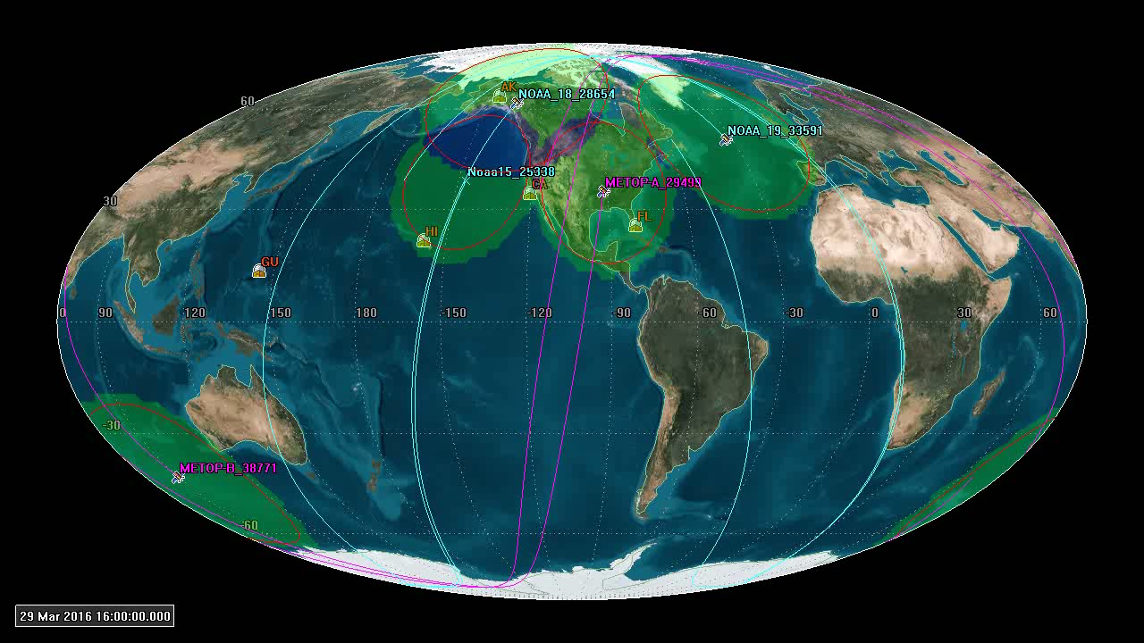
LEOSAR Coverage

Slide 10
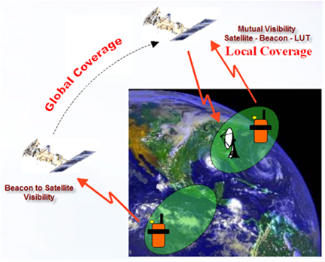
Present LEOSAR System Two Modes of Operation
CRC-MEOSAR-Feb08

Slide 11
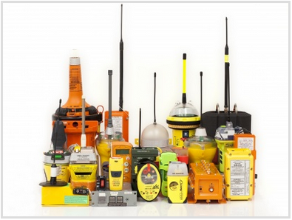
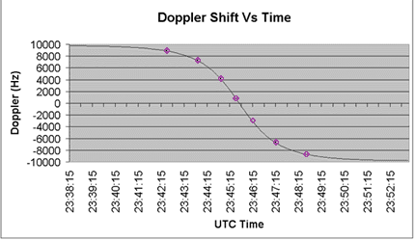
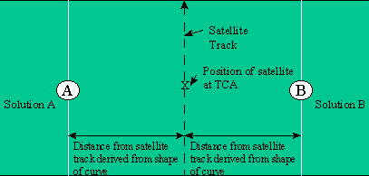
406 MHz Distress Beacons and LEO Processing
Transmit signals: ½ second bursts, one burst every 50 seconds
Each burst contains 120 bits of digital information
The job of a LUT is to get the burst(s) relayed via satellite, and as possible, “independently” compute a location

Slide 12
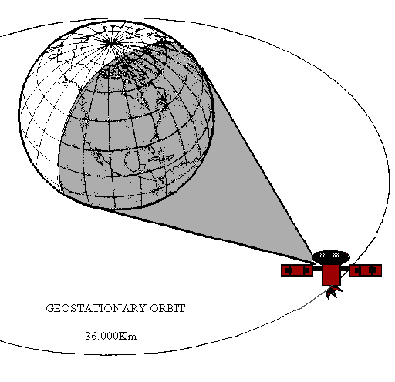
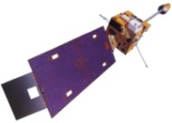
Present GEOSAR System
36,000 km high: Geostationary satellites relay transmissions from beacons
GEOLUTs only “detect” alerts and repeat the digital message
Large, fixed coverage areas
With no relative motion between beacon and satellite there is no Doppler effect on signal to use for determining location
Location is available only if beacon has a GNSS receiver chip and encodes the location in the beacon message
Geostationary Orbit
36,000 km

Slide 13
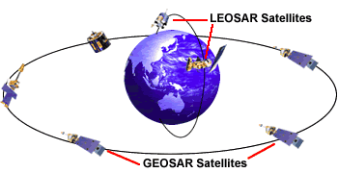
Combined LEO/GEO System
At 406 MHz, the Cospas-Sarsat system combines the benefits of its LEO and GEO components:
  Global LEOSAR coverage
  Real-time GEOSAR alerting
  Independent LEOSAR Doppler positioning capability
  Highly accurate GNSS positioning (in equipped beacons)
  High probability of LEO detection even when GEO blocked
  High system capacity
Notes:
The best of both worlds, combining the global coverage of GEO satellites and the Doppler location abilities of LEO satellites.
Also allows detection of disasters in GEO shadow areas.
The LEOSAR system has the unique advantage of providing a Doppler location capability, and at 406 MHz, complete coverage of the globe. However, the LEOSAR coverage is not continuous and the users in distress may have to wait for a satellite to come into visibility of their beacon.
Geostationary (GEO) satellites are at a fixed position relative to the Earth, thereby providing continuous coverage of a specific geographic area. However, the GEOSAR coverage is limited to about 75º latitude, and the GEOSAR system has no independent location capability. To take full advantage of the real-time GEO satellite alerting capability, the distress beacon must be designed to transmit position data derived from global navigation satellite systems (GNSS) such as GLONASS or GPS, in its distress message.

Slide 14
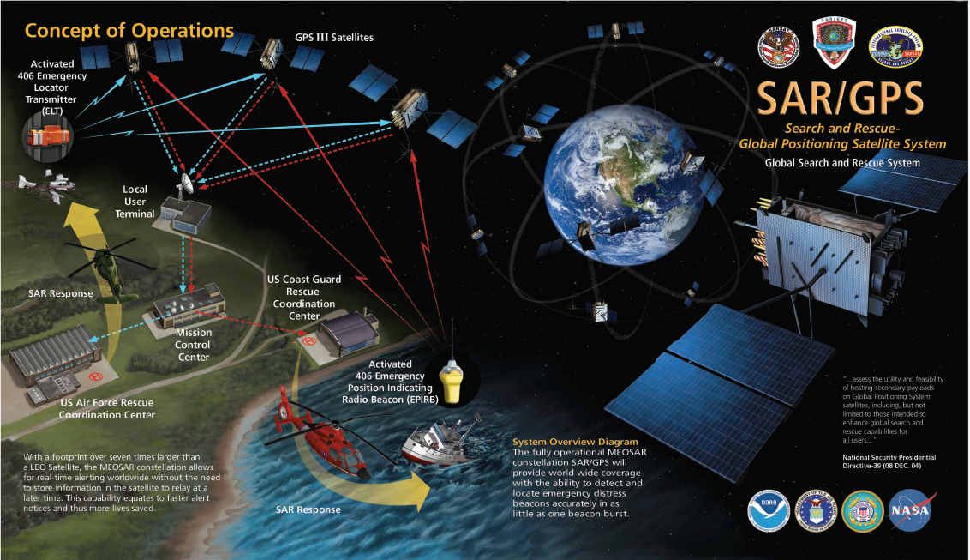
MEOSAR Concept of Operations

Slide 15
Distress Alerting Satellite System (DASS) Overview
Experimental Satellite-based signal repeater for 406-MHz search & rescue (SAR) beacons
  Proof of Concept Testing completed in 2011
  Demonstration and Evaluation of operational concept 2013-2017
Passive “bent-pipe” signal relay
Proposed for flight aboard GPS IIR, IIF and III SV1-8 satellites – up to 28 satellites
  Currently 20 DASS capable satellites in orbit

Slide 16
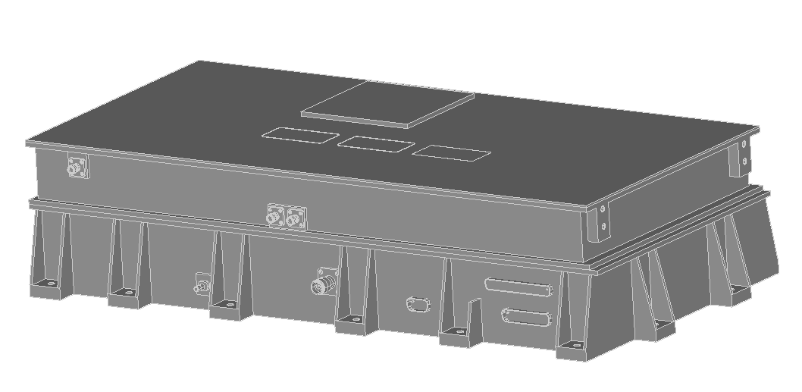
Search and Rescue/GPS (SAR/GPS)
Search and Rescue/GPS (SAR/GPS), is a joint US/Canada effort to develop, produce, and integrate 24 SAR payloads onto GPS III SV11+
$120M Canadian Investment
Proposed SAR/GPS Assembly from Canada
1
Increased electrical power and thermal load limit to increase RF performance for users
3
Shielding upgraded to enhance SAR/GPS performance in the GPS Space Environment
2
Realignment of SAR/GPS mounting feet to avoid Space Vehicle interferences
4
Increase in telemetry interfaces to enable clear picture of on-orbit operations of SAR/GPS
  SAR/GPS is an important, high visibility program for US and Canada

Slide 17
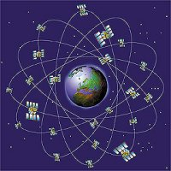
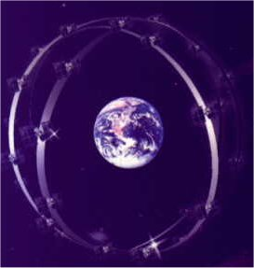

Future MEOSAR System Fleet
MEOSAR Includes SAR Payloads on
Three Global Navigation Satellite Systems
GPS / USA
Glonass / Russia
Galileo / Europe

Slide 18
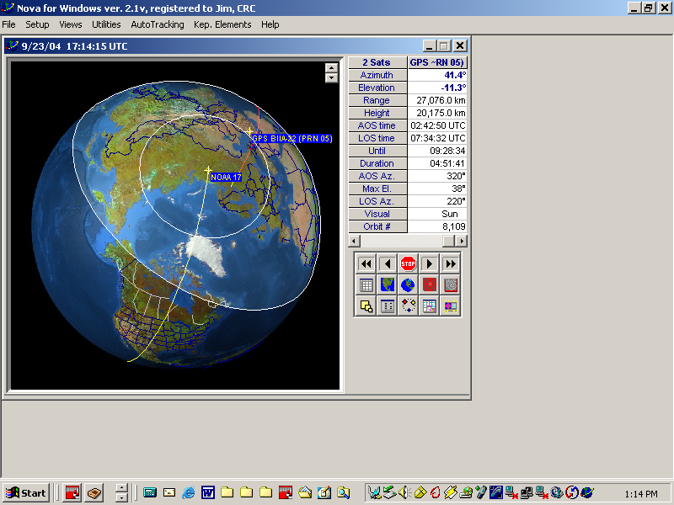
MEOSAR System Benefits
Near instantaneous detection and location
Continuous global coverage
System is automated
24 / 7 system availability
Mitigates terrain masking in GOES
Reduces rescue response time
Robust space segment / highly redundant
Satellite repeater intentionally simple to allow for future beacon innovation

Slide 19
MEOSAR – Independent Location
Similar to standard GPS receivers, but in reverse, MEOLUTs use multiple satellites to compute the location of a 406 MHz beacon
This location is “independent” of the location produced within the beacon (and encoded within the beacon message)
The actual methodology used by MEOLUTs uses Trilateration ( standard triangulation techniques, with 3 unique satellites providing a “2D” location (latitude and longitude), and 4+ providing a “3D” location (includes altitude)
Rather than just using differences in the time the signal takes to be relayed to the ground (like GPS receivers), MEOLUTs use differences in frequency as well, which leads to twice as many measurements and a more complex location generation algorithm (e.g., an iterative approach such as linear regression, which refines the location estimate until it converges)
The measurements refer to the relayed satellite signal as received at the MEOLUT, and are named Time of Arrival (TOA) and Frequency of Arrival (FOA), and the independent location generated captures both as Difference of Arrival, or a DOA location

Slide 20
MEOSAR – Independent Location (cont.)
A major advantage of MEOSAR is that DOA locations can be generated from a single burst from a 406 MHz distress beacon
In addition, a MEOLUT will combine data from multiple bursts, which improves accuracy
When the MEOLUT first computes an independent location (i.e., on a single burst) it will immediately send that location to the Cospas-Sarsat Mission Control Center (MCC)
Thereafter, independent locations will generally include multiple bursts (composite locations), and will be forwarded to the MCC at a minimum of 5 minutes intervals, and more often if better quality is indicated or new information if available (e.g., encoded location first available or changed)

Slide 21
MEOSAR – Independent Location (cont.)
There are a number of factors that can affect the accuracy of a MEOSAR independent location, but the most important are:
  The number of unique satellites for which burst data is received
    Satellite in view of beacon and the MEOLUT (mutual visibility);
    Whether or not the relay actually works (throughput); and
    The geometrical position of the satellites (dilution of position – DOP)
  The accuracy of the TOA measurements
  The accuracy of the FOA measurements
  As a beacon position gets further away from the MEOLUT the number of mutual visibility satellites is reduced
  When satellites are at very low or very high elevation angles to the beacon, throughput is reduced (high angle degradation is due to beacon antenna patterns)
  Interference on the 406 MHz band impacts throughput and measurement accuracy, and stems in part from large satellite ground footprints as well as the characteristics of some MEOSAR repeaters

Slide 22
MEOLUT Networking
MEOLUT Networking refers to the exchange of TOA/FOA data “directly” between MEOLUTs, and is considered an additional capability
The purpose of this data exchange is to enhance the performance of the MEOSAR system, specifically helping to compensate for:
  A large distance between the beacon and the MEOLUT
  Missed data caused by limited throughput
This data exchange of “raw” data, is NOT to be confused with the sending of alert data (processed data) that occurs between C/S MCCs using the Nodal communications “network”
MEOLUT #1
Alert Data
MCC #1
Alert Data
RCCs/SPOCs
TOA/FOA
Data
Alert
Data
MEOLUT #2
MEOLUT #3
Alert Data
MCC #2
Alert Data
RCCs/SPOCs

Slide 23
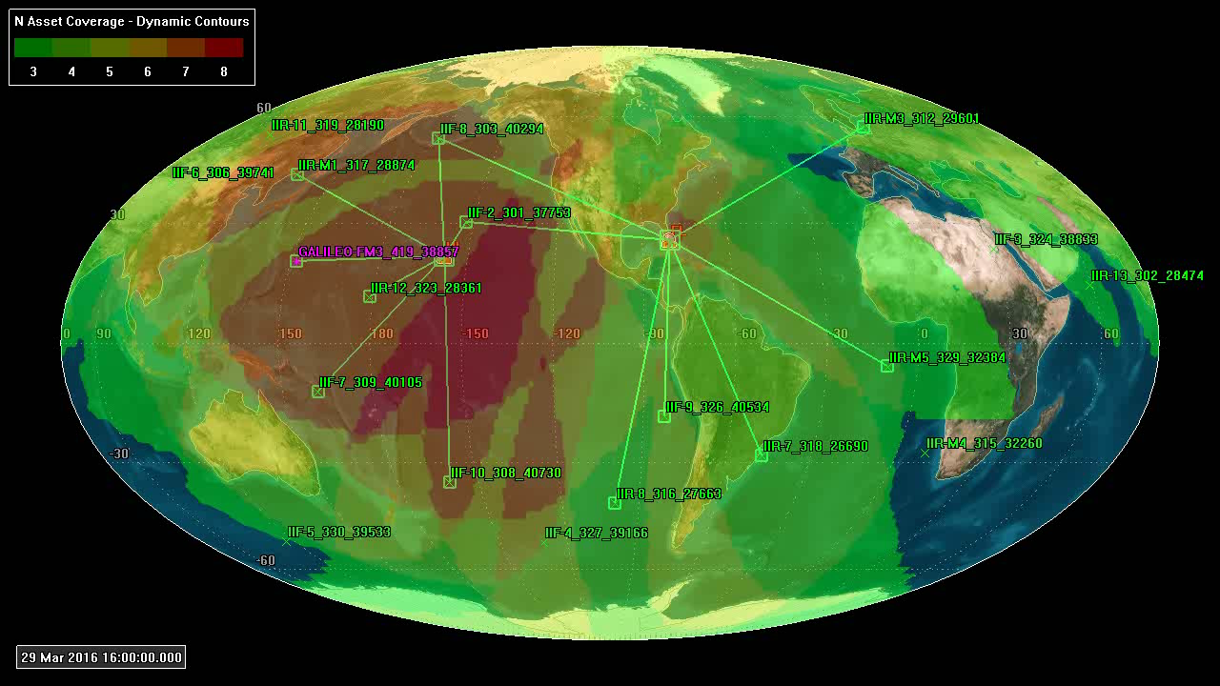
Networked MEOSAR Coverage
Notes:
19 MEOSATs (18 DASS and 1 GALILEO) – Two ground stations at FL and HI with networked coverage.

Slide 24
Quality Factor
With Independent, composite and networked locations some method is needed to determine the quality of all these locations
Expected Horizontal Error – will determine quality
  Each MEOLUT independent location will be provided to the MCC with an expected horizontal error, which not only helps predict a potential search radius, but more importantly provides a measure of quality for comparing locations and sending additional data when indicated
  For the expected horizontal error, a given DOA position is expected to within that radius with probability of 95% (+- 2%)

Slide 25
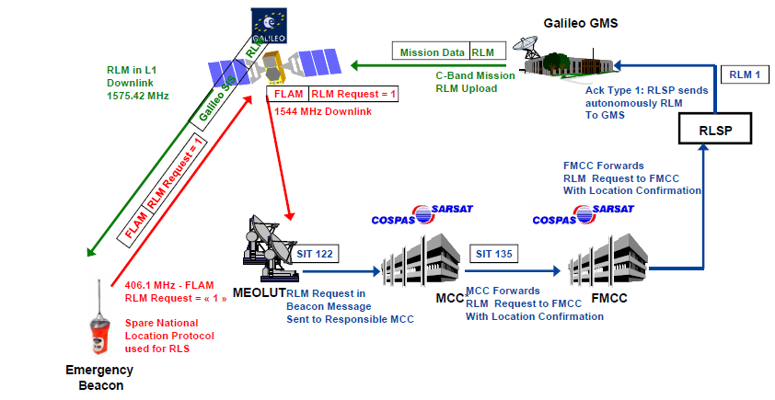
Galileo Return Link Service (RLS)

Slide 26
Case Studies

Slide 27
MEOSAR Evaluation System Performance vs. LEO/GEO
Jan 14, 2016 Cuba
On 14 January 2016 at 1527 UTC the COSPAS-SARSAT system detected a 406 MHz EPIRB at 21 18.4N 080 09.4W, 66 NM south west of Cuba. The EPIRB was manually activated when the S/V Marmouz became disabled due to engine problems, with two people on board. Coast Guard District 7 (CGD7) received the SARSAT alert and contacted the Cuban Aviation RCC (ARCC), after contacting Cuban authorities who stated they had no surface means to respond. With permission given by ARCC, CGD7 launched a HC-130 fixed wing aircraft that flew over Cuba and established communication with the vessel. CGD7 directed the vessel's crew to keep the EPIRB active for tracking until a Coast Guard vessel arrived on scene. The HC-130 broadcast a Marine Assistance Request Broadcast (MARB). CGD7 notified the Cuban Border Guard (CBG) that a US Coast Guard vessel was inside Cuban territorial waters, deployed their surface unit, established communication with the S/V Marmouz. The CBG towed the vessel to port.
Case Evaluation notes (FL MEOLUT 278 mi away-----HI MEOLUT 4900 mi away)
Encoded location beacon but Encoded vs. Ground Truth location is off from 13.3 to 11.8 km during first 30 minutes of case period. Ground Truth questionable over time for drifting boat.
First encoded location through FL MEO at 1531 UTC
First computed location through FL MEO at 1533 UTC,
First GEO encoded reported at 1534 UTC
At 1601 UTC, FL MEO computed location and encoded location were <1 km apart
First LEO computed doppler location (A & B) computed at 1607 UTC, encoded loc resolution resolved ambiguity

Slide 28
MEOSAR Evaluation System Performance vs. LEO/GEO
Jan 15, 2016 Hooper Bay, Alaska
On 15 January 2016 at 1925 UTC the COSPAS-SARSAT system detected a 406 MHz ELT at 61 27.7N, 166 10.5W, at Hooper Bay Airport, Alaska. The ELT was activated when a small plane landed off-runway due to damaged runway lights. The Alaska Rescue Coordination Center received the SARSAT alert and contacted the aircraft operator. No encoded location, airport provided ground truth location.
Case Evaluation notes (FL MEOLUT 4550 mi away-----HI MEOLUT 2850 mi away)
HI MEOLUT 2850 mi away computes location at 1925 UTC, within 3.87 km from ground truth.
GEO detects unlocated alert 1925 UTC
Next two HI MEO computed locations at 1934 UTC & 1935 UTC have computed locations with larger errors from ground truth but 1935 UTC solution compares with 1925 UTC solution and higher Quality Factor
First LEO computed location reported at 2327 UTC, verified at 2333 UTC
At 2334 UTC FL MEO computed location and 5.95 km from ground truth
Note that stand-alone performance for HI MEOLUT was very good.

Slide 29
MEOSAR Evaluation System Performance vs. LEO/GEO
Jan 16, 2016 Breckenridge, Colorado
On 16 January 2016 at 2249 UTC the COSPAS-SARSAT system detected a 406 MHz PLB at 39 24.2N, 106 03.8W, approximately five miles south of Breckenridge, Colorado. The PLB was activated when a hiker became lost. The Air Force Rescue Coordination Center received the SARSAT alert and notified the Summit County, CO Sheriff's Office (SCSO) of the distress. The individual in distress was recovered by an SCSO rescue team and taken to a safe location.
Case Evaluation notes (FL MEOLUT 1750 mi away-----HI MEOLUT 3280 mi away)
GEO produces unlocated alert at 2249 UTC
FL MEO produces computed location at 2249 UTC, location error from reported ground truth, 13.71km
Next FL MEO computed location at 2259 UTC has computed location with 2 km error from ground truth.
First LEO computed location reported at 2309 UTC, verified at 2333
At 2314 UTC FL & HI MEOs report encoded locations <1km from GT
At 2317 UTC first GEO encoded locations reported with 12 km errors
FL MEO performance in stand alone mode was good for this case.
HI MEO never computed a location for this case, only encoded locations.

