Slide 1

Innovative Visco Elastic Dampers for Shock and Vibration Control
Tony DEMERVILLE (SMAC, tony,demerville@smac.fr)
www.smac-sas.com ZI Toulon-Est BP 119 83079 Toulon Cedex 9 France

Slide 2
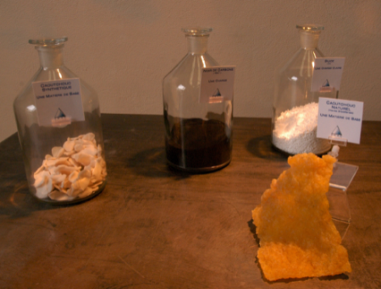
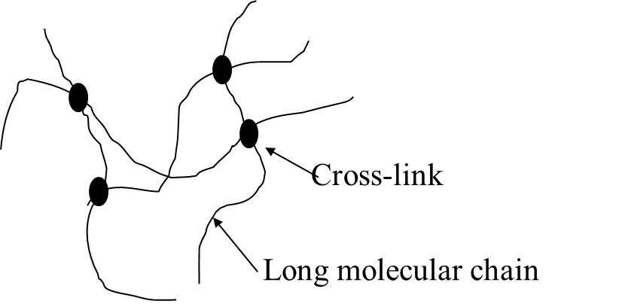
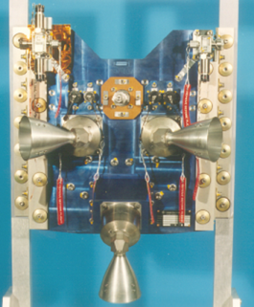
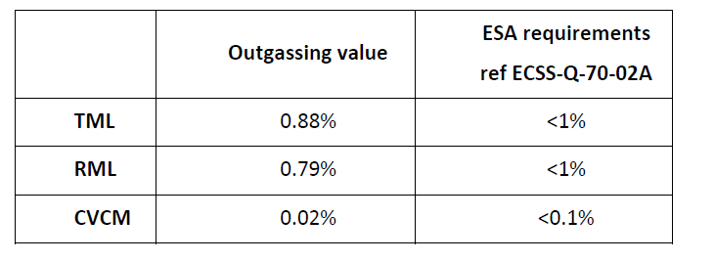

  What about visco elastic materials?
  Polymer materials with various additives (Vulcanizing agents, reinforcing charges, protecting agents,…)
  Viscoelastic material = Thermoset material
  Various possibility to tune the material regarding the requirements, and the environnement conditions,as the space constraints
  Outgassing values of SMACTANE 50 SP

Slide 3
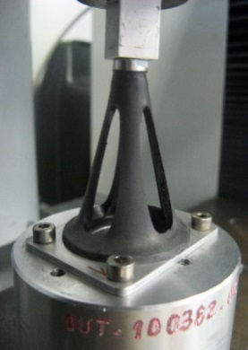
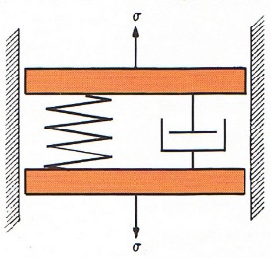
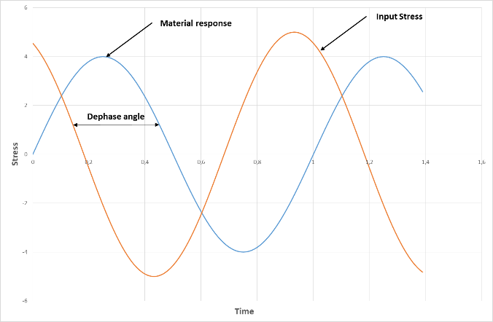
  Visco elastic materials and mechanical behavior
  Soft material with an extreme flexibiliy : Hyper-elactic behavior
  Visco-elasticity defined by a storage modulus (E’)
  and a loss modulus (E’’)
  Ultimate tests on IMU damper

Slide 4
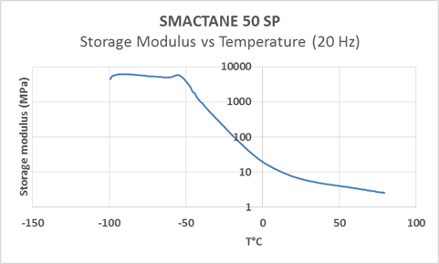
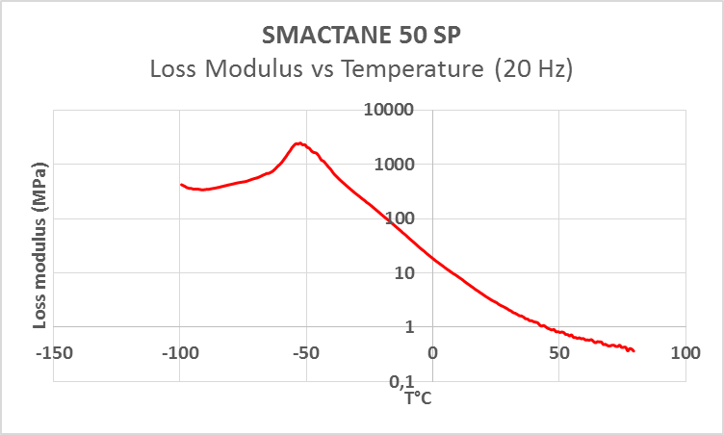
  Visco elastic materials and mechanical behavior
  Effect of the temperature on the moduli :
  Effect of the frequency on the moduli :
  SMACTANE 50 SP and DMA tests

Slide 5
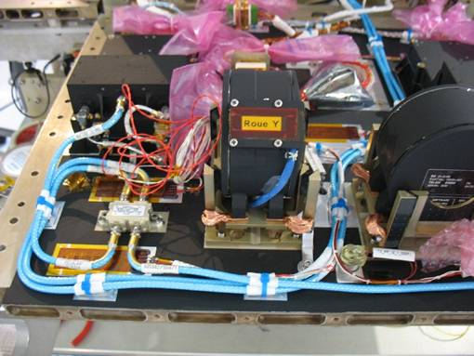
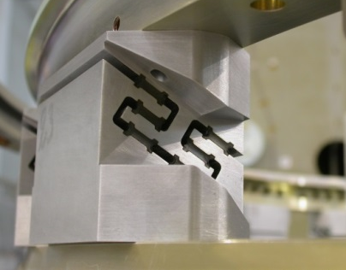
  Visco elastic materials and mechanical behavior
  Effect of the strain onthe moduli :
  ➔Visco-elastic material = Various No linearity effects but very interesting to solve dynamic problems !
  PAYNE EFFECT
  SMACTANE 50 SP and DMA tests

Slide 6
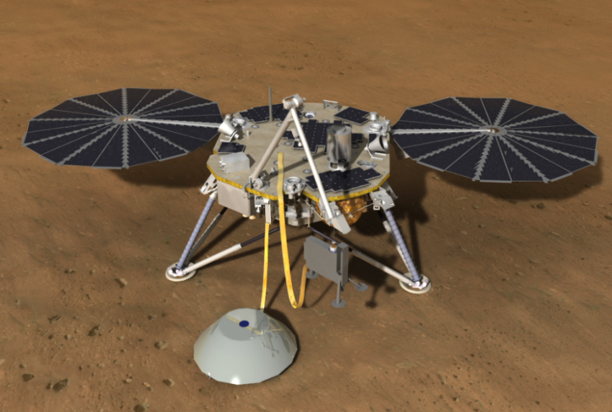
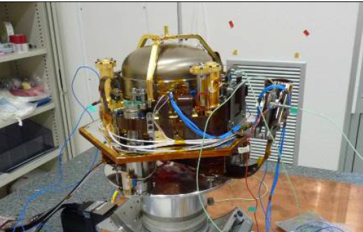
  Viscoelastic damper for SEIS/INSIGHT payload
  INSIGHT : NASA Discovery Program mission on Mars proposed by JPL with several european partners
  Objectives : To improve the scientific knowledge about the planet formation process by measuring the planet “vital signs”
  View of the SEIS Payload

Slide 7
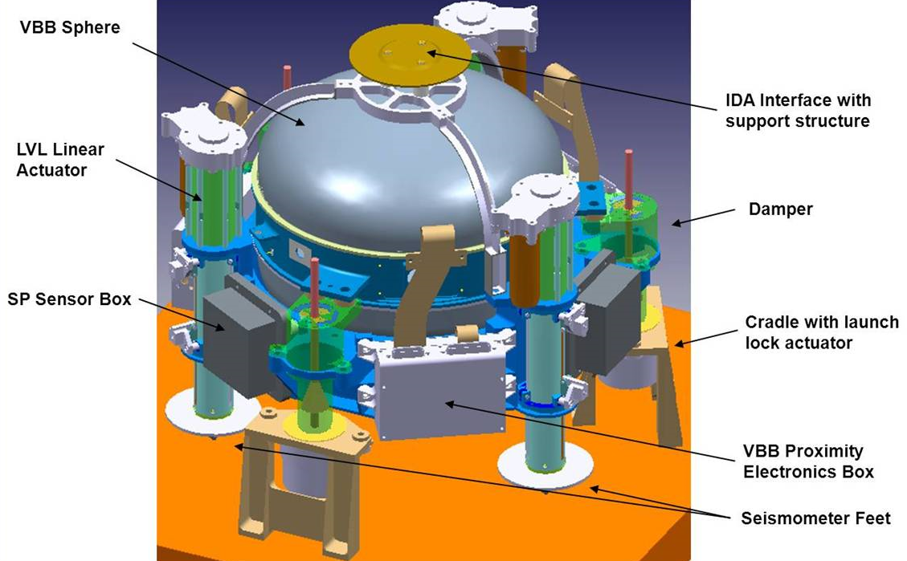
  Viscoelastic damper for SEIS/INSIGHT payload
  Launch phase & Landing phase : Random + Shocks
  About the Shock events : Usual launch shocks, Activation of lock actuators , deployment of seismometer,….
  The payload can not survive to
  this mechanical environment !!!
  SMAC is selected to design a visco-elastic damper to protect the SEIS payload

Slide 8
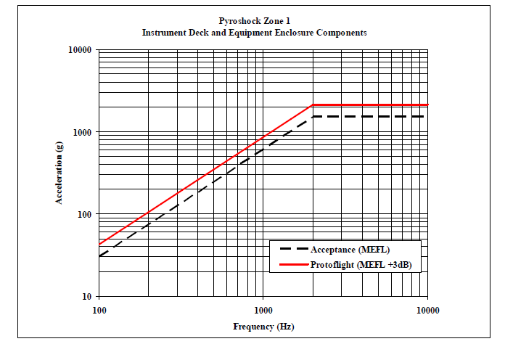
  Design of the dampers : Review of the specification
  Mass of the suspended payload : 8,0Kg
  Localisation of the dampers : Aligned with the suspended CoG
  Mechanical random levels : 7,16 grms
  Shock environment profile : 2200g from 2kHz up to 10kHz

Slide 9
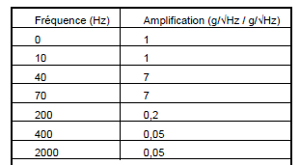

  Design of the dampers : Review of the specification
  Temperature range, Random : -20°C / +45°C
  Temperature range, Shock events : -50°C / +35°C (Mars landing)
  -60°C / +60°C (Release events)
  Random and Attenuation requirements :
  Shock Attenuation requirements :

Slide 10
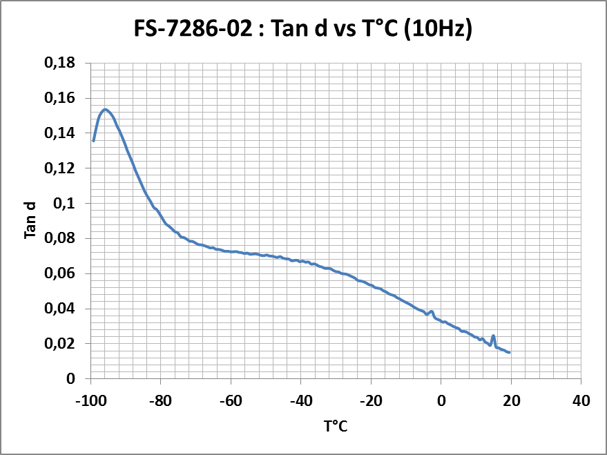
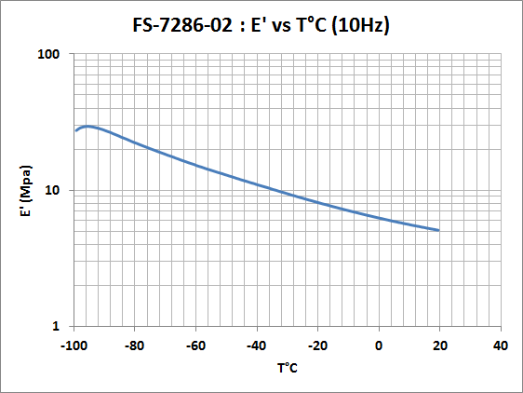
  Design of the damper, choice of the visco-elastic material
  Visco-elastic material : Very low Glass Temperature (Tg) to be compliant with the required attenuation up to -60°C !
  The SMAC rubber ref MB1176-01 (FS-7286-02) was compounded
  )
  Space environment constraints (outgassing, radiation, ageing) : OK

Slide 11
  Design of the damper, stiffness assessment and rubber shape
  Stiffness assessment coupled with allowable volume : A conical rubber shape is choosen :
  The Axial/Radial stiffness ratio is driven by Dext, H, t and α
  Static stiffness : Analyses by FEMs (Hyperelastic Neo-Hooke behavior law)
Dext
H
α
t

Slide 12
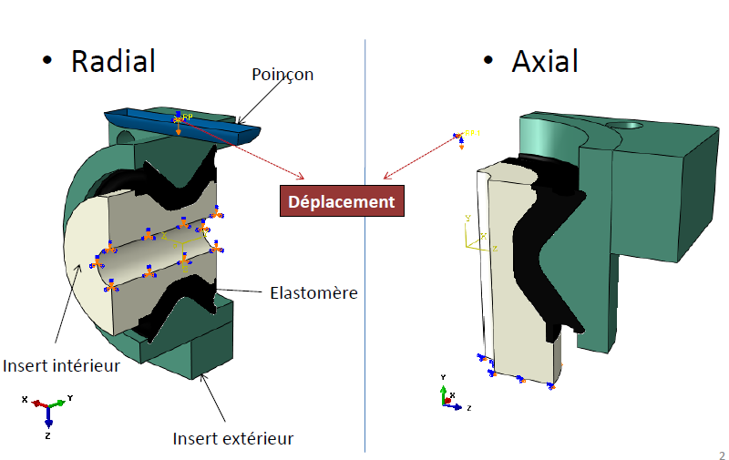
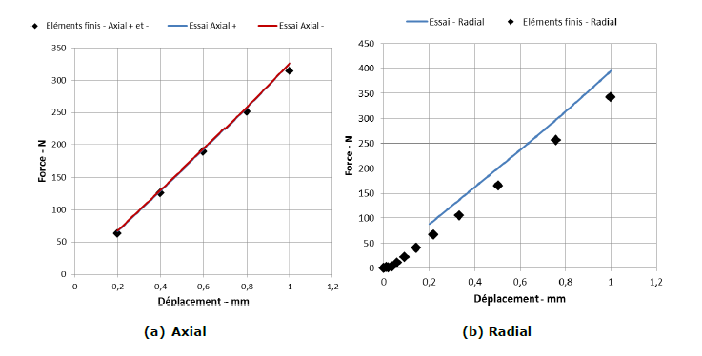
  Design of the damper, stiffness assessment and rubber shape
  The nominal rubber design (Mock-up type A) is defined by analyses :
  Short schedule and no-linear effects of rubber : 2 back-up rubber design (Mock-up tye B and type C) are defined (and manufactured) !

Slide 13
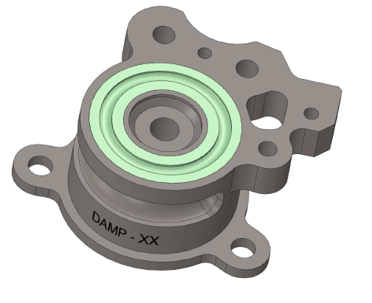
  Design of the damper, QMs & FMs
  View of the QMs/FMs design:
  External metallic housing : Titanium (Ta6V)

Slide 14
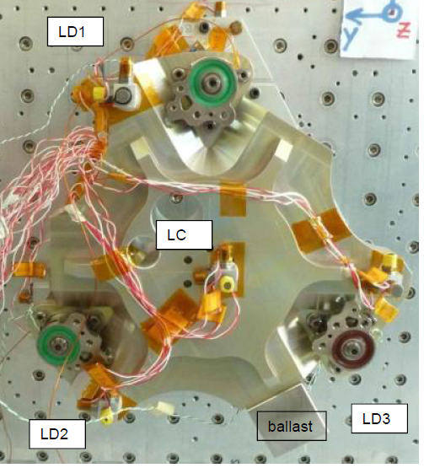
  Final configuration, QMs & FMs
  Evolution of the input data : Following X&Y axis (IP), the CoG is not centered regarding the location of the 3 dampers !
  ➔There is a major risk not to get the attenuation rate due to the rocking modes !
  Solution : To increase the stiffness of the damper located close to the CoG by adjusting the rubber compund (MB1176-01=>MB1183-01)
« Soft damper »
« New » positioning of CoG
« Soft damper »
« Hard damper »

Slide 15
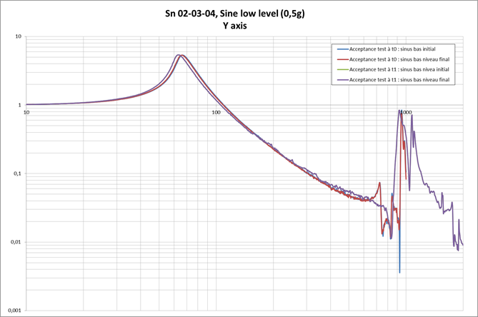
  Random qualification tests, QMs & FMs
  Random qualification tests : -20°C, +20°C & +45°C (ADETESTS Lab)
  Mechanical strenght : OK (low evolution of the FFT under sine low level) :

Slide 16
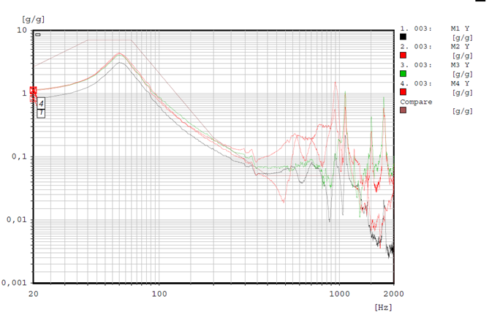
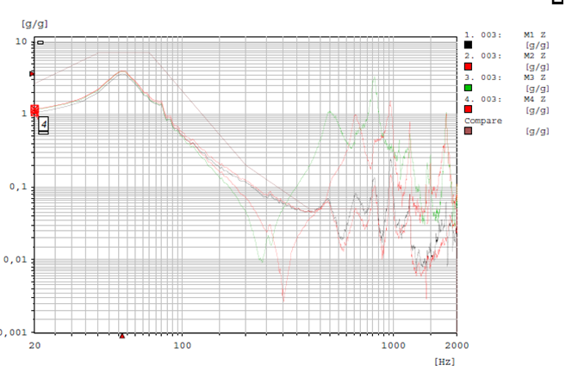
  Random qualification tests, QMs & FMs
  Attenuation under random levels : OK for the 3 axis from -20°C up to +45°C
Y axis, -20°C
Z axis, -20°C

Slide 17
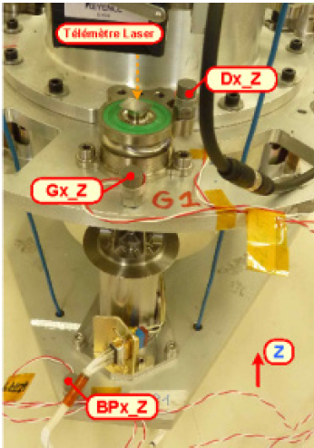
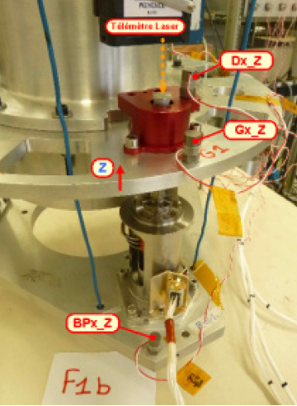
  Shock tests: Suspended vs No-Suspended payload
  Shock tests based on a dummy mass and Frangibolt activation (CNES pyrolab)
  A soft damper is replaced by a « rigid damper »
Soft Damper
Rigid Damper

Slide 18
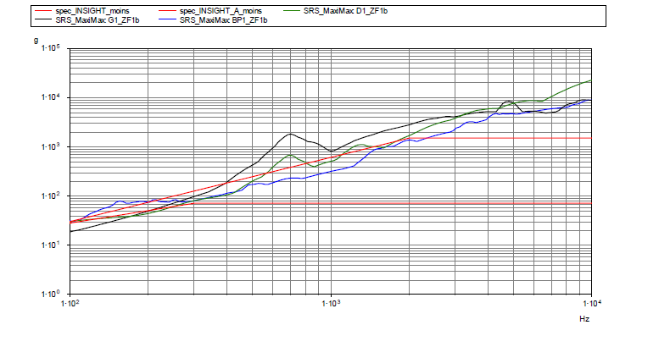
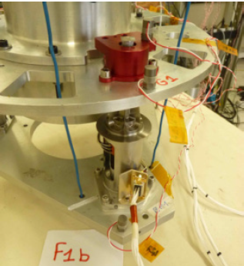
  Shock tests: Suspended vs No-Suspended payload
  Main results in rigid configuration :

Slide 19
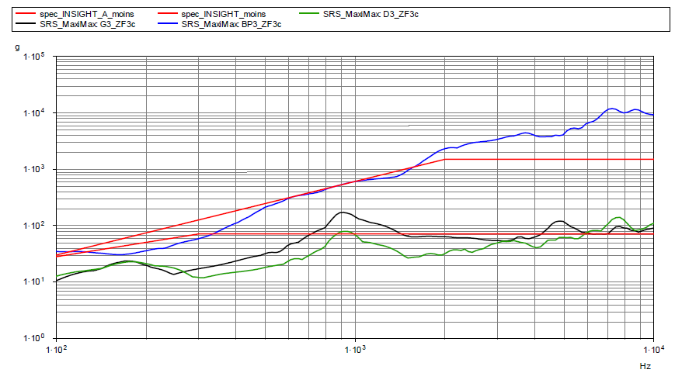
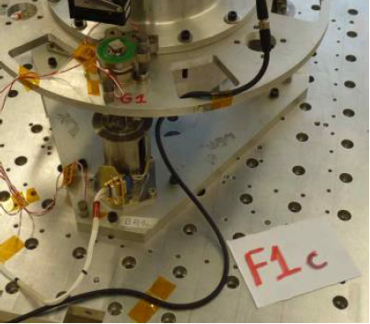
  Shock tests: Suspended vs No-Suspended payload
  Main results in soft configuration :

Slide 20
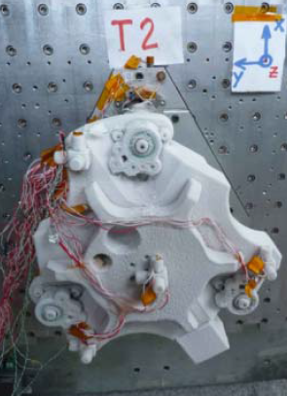
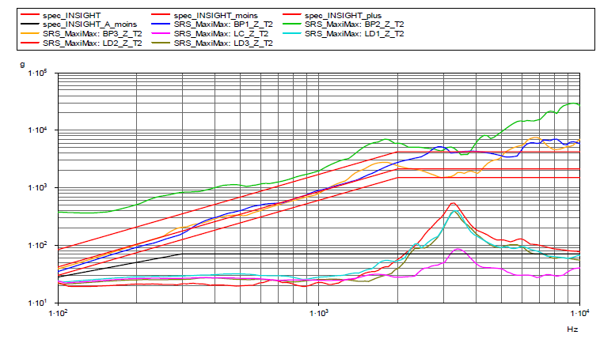
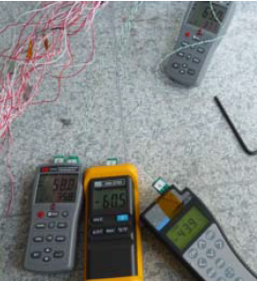
  Pyroshock testing under extreme qualification temperatures
  At -52°C :
Z axis (OOP)

Slide 21
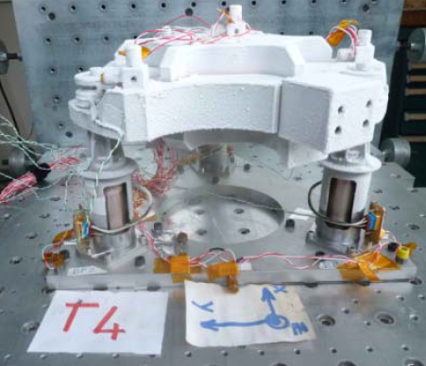
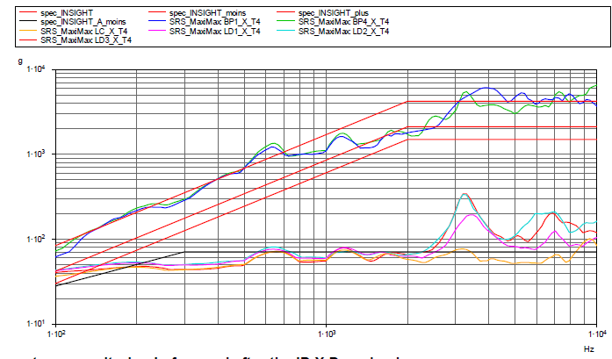
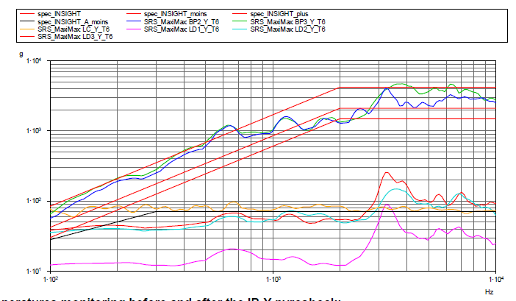
  Pyroshock testing under extreme qualification temperatures
  At -52°C
X axis (IP)
Y axis (IP)

Slide 22
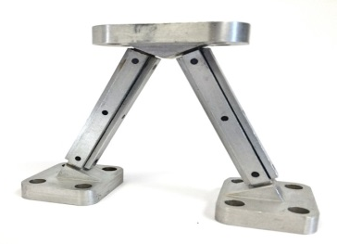
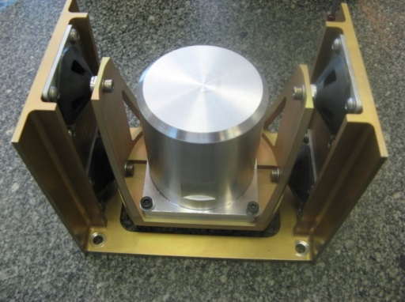
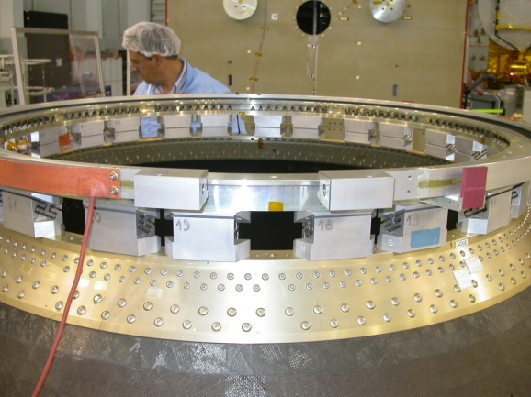
  CONCLUSIONS
  Visco-elastic material can be tuned regarding Space Operational Conditions (temperature, outgassing, radiations,…)
  Used as shock and vibration control thanks to damper, isolatorn tuned mass damper, structural damping,….
  New way : Earth observation satellite and decoupling of spinning actuaors which can effect the quality of pictures !

Slide 23
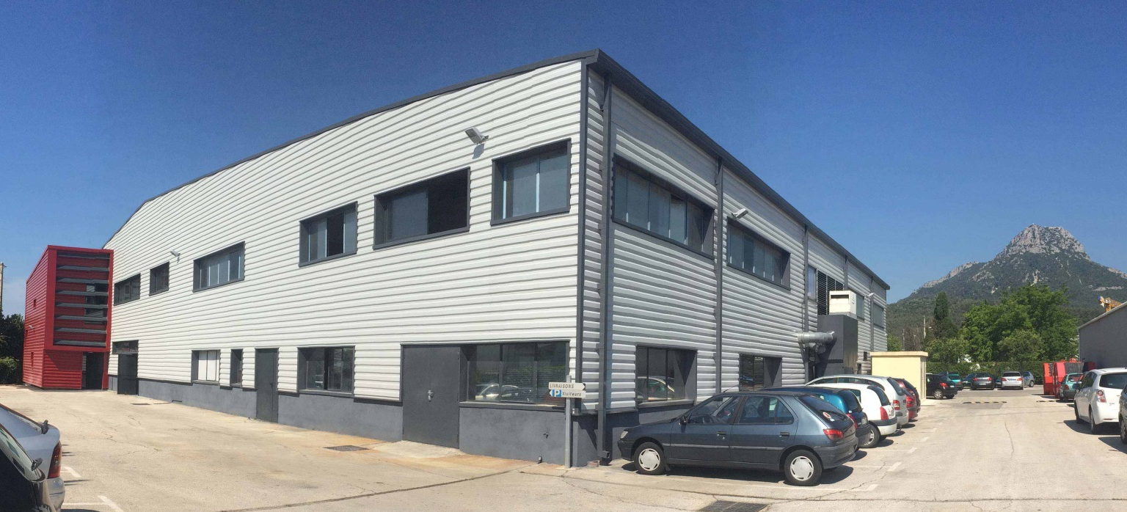
SMAC Company
Thank you for your attention

